Slide 1
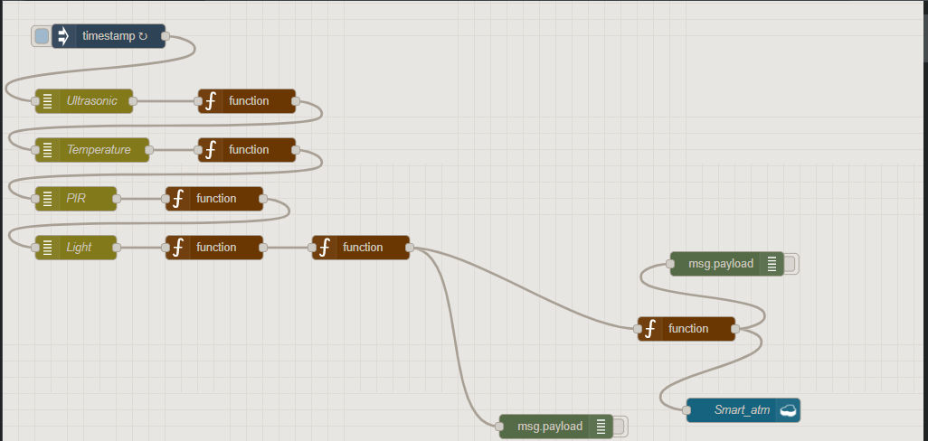
Our Current Solution

Slide 2
Current Solution Prospects
Huge energy savings, reduced cost.
Energy savings
Lowered cost
Increased uptime
Cleaner environment
Easy acceptance, widespread adoption

Slide 3
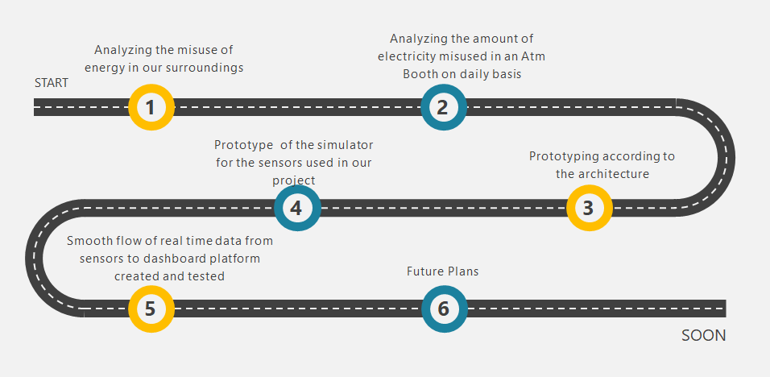
The Roadmap

Slide 4
Future Plans
Stored data in database with the help of Artificial Intelligence and Machine Learning will help us to use the energy in the ATM Booth in the most efficient way.
By analyzing the stored data from the database we can generate the atm booth usage data, atm booth health data, energy consumption data.
We can map all the atms region wise having a centralized administrative system to monitor them remotely.
The same plan can also be implemented to NBFC institutions and other booth type e-corner setups

